Slide 1


Slide 2








Data Olympians
CALUM
RUCHI
The only sport we medal in is data !!
MOHAMED
MINNIE

Slide 3
Initial Proposal
For the team project, the chosen theme that has been decided is data within Olympics. The time interval will be from the Athens Olympics Athens 1896 to Rio 2016.
The dataset gives the result (Gold, Silver, Bronze) for each sporting event including all participating countries. The questions that we will attempt to answer are.
1
The medal count between the Male athlete’s vs the Women athletes
2
Are women better represented at the Summer or Winter Olympic games
3
Map to show which countries have hosted the Olympics and how female representation has grown over the years

Slide 4










Initial proposal continued

Slide 5


Sources
Columns that were cleaned from the data frame:
Height - In centimeters
Weight - In kilograms
Age - Integer
The Data source we acquired for the project was a CSV file that consisted of all the winners from the Olympics games. The variable within the file:
ID - Unique number for each athlete
Name - Athlete's name
Sex - M or F
NOC - National Olympic Committee
Games - Year and season
Year - Integer
Season - Summer or Winter
City - Host city
Sport - Sport
Event - Event
Medal - Gold, Silver, Bronze, or NA
Hyperlink:
120 years of Olympic history: athletes and results | Kaggle

Slide 6


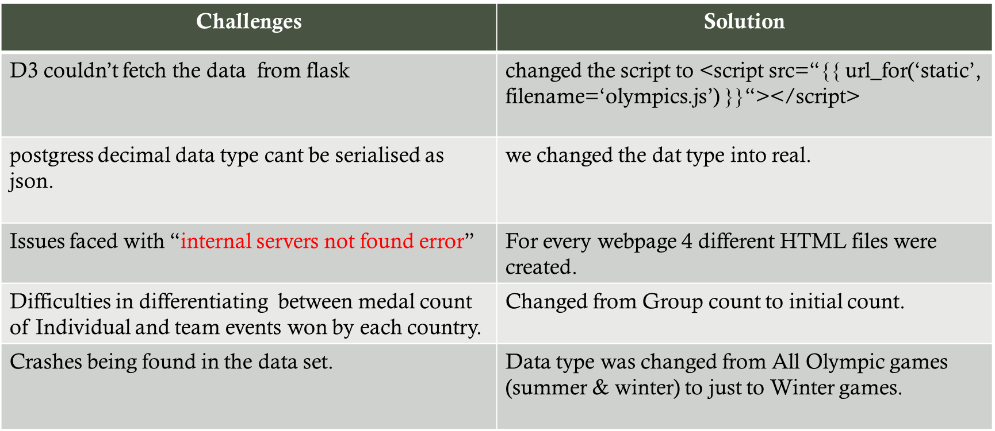
Challenges

Slide 7

Achievements
Gender Split displaying growth in participating females
Medal Count of Countries in a timeline of the Winter Games.
Background information of the Winter Olympics.
Hosting Countries achievements have been shown in each year.

Slide 8
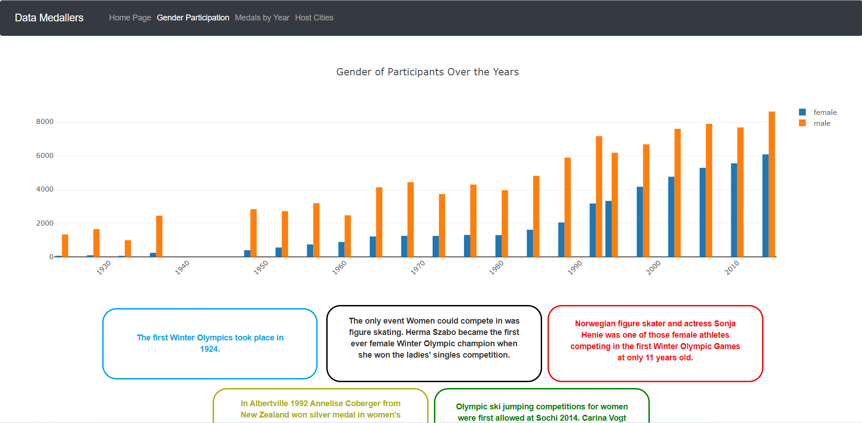
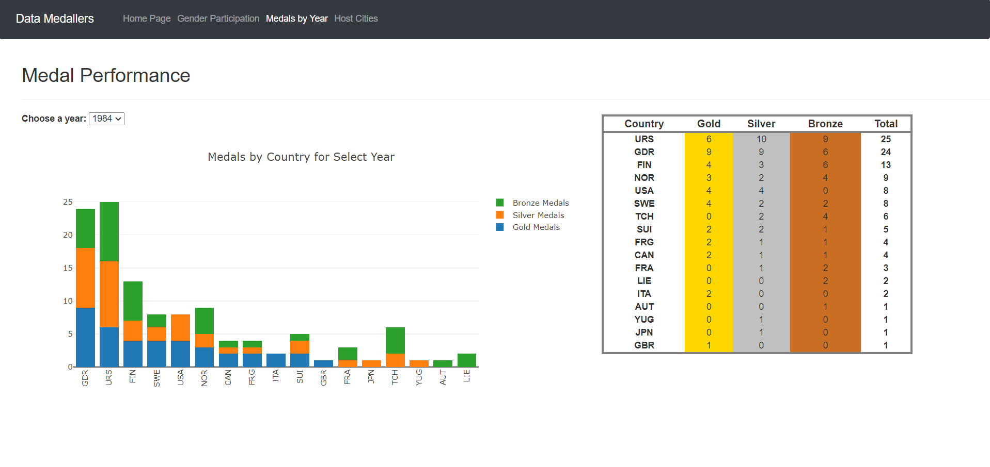
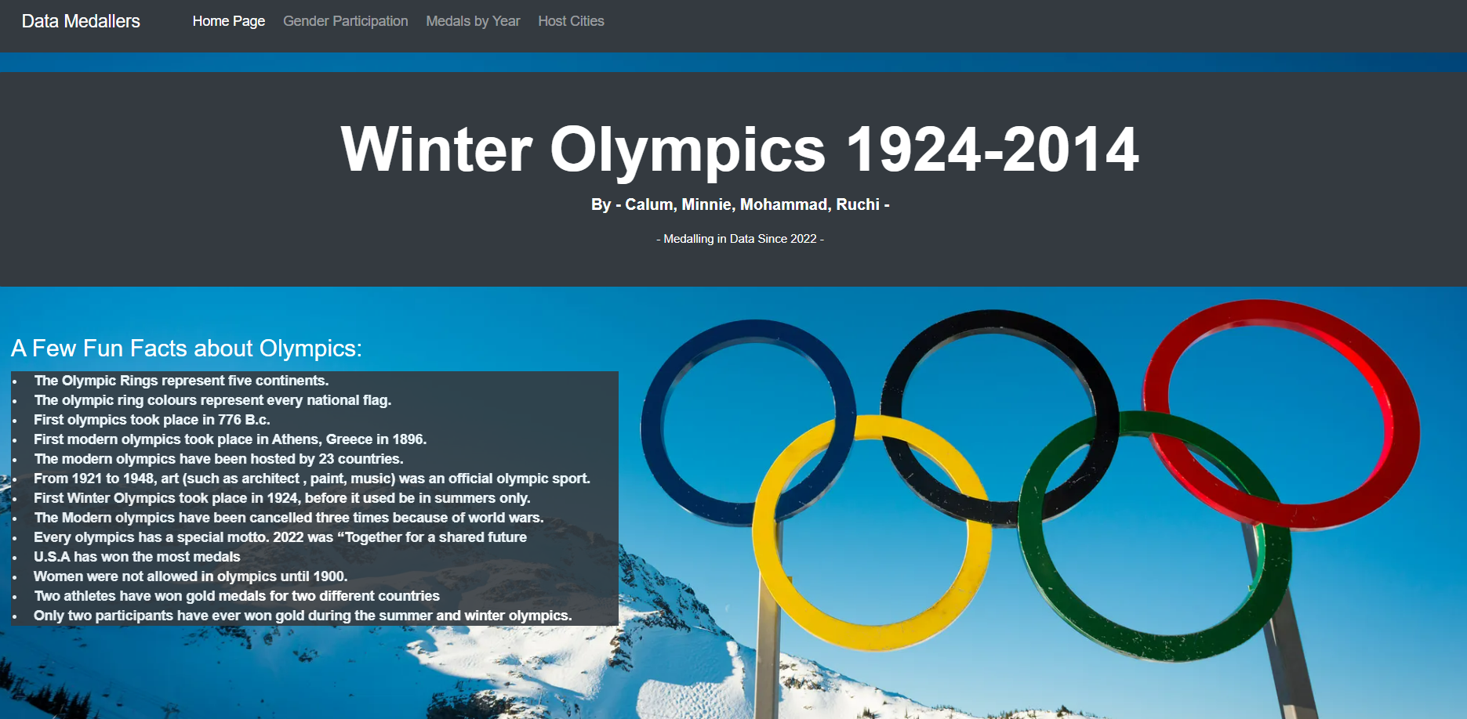


Webpage

Slide 9
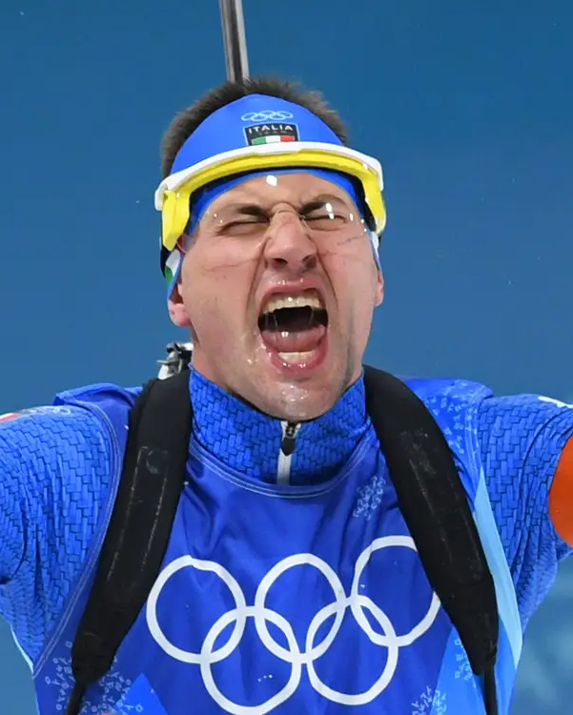
Our Dashboard

Slide 10

Thank you for listening
CALUM
RUCHI
Of course, its about winning .. No one plays just to take part !!
MOHAMED
MINNIE

